Slide 1


Udit Deshpande
2022-09-09

Slide 2

Outline
Executive Summary
Introduction
Methodology
Results
Conclusion
Appendix

Slide 3
Executive Summary
The objective of this data science engagement was to predict the success/failure of a landing of the Falcon 9 rocket based on the information available. The information required to make these predictions were obtained from SpaceX APIs and some publicly available data points published in Wikipedia.
Based on the data available and features observed by generating various plots with respect to the outcome, it was observed that payload mass, orbit, launch site, location and reused count played a significant part in the determination of the success or failure of the outcome.
After retrieving the data, treating the null values, and appropriately transforming the data, a ‘best’ split ‘entropy’ criterion decision-based tree model was built using grid search to predict the landing success or failure with an accuracy of 94.5%.
Notes:
Summary of methodologies
Summary of all results

Slide 4
Introduction
A company Space Y wanted to analyze the data of the SpaceX Falcon 9 and determine if they could calculate the cost of deploying a satellite in the orbit. A sizable contribution to this cost is based on the outcome of the SpaceX Falcon 9 landing. If the landing is successful, the first phase of the rocket could be reused which could save the costs by approximately $62M. However, a landing failure could increase the cost of the launch.
The main objective of the project was to retrieve the publicly available data related to Falcon 9 launches by SpaceX and determine whether the outcome of the launch was a success or a failure.
Notes:
Project background and context
Problems you want to find answers

Slide 5

Section 1

Slide 6
Methodology
Executive Summary
Data collection methodology:
Data was collected using the SpaceX APIs for Falcon launches.
Web scraping using the Wikipedia pages for Falcon launches and other relevant information.
Perform data wrangling
Data was cleaned for any special characters, formatting errors, etc.
Null values were addressed appropriately by assigning mean values.
Perform exploratory data analysis (EDA) using visualization and SQL
Perform interactive visual analytics using Folium and Plotly Dash

Slide 7
Methodology (Contd.)
Executive Summary
Perform predictive analysis using classification models
Data that was collected until this step were normalized, divided in training and test data sets and evaluated by four different classification models, being the accuracy of each model evaluated using different combinations of parameters.

Slide 8
Data Collection
Data sets were collected from Space X API (https://api.spacexdata.com/v4/rockets/) and
Wikipedia (https://en.wikipedia.org/wiki/List_of_Falcon/_9/_and_Falcon_Heavy_launches), using web scraping technics.

Slide 9
Data Collection – SpaceX API
Request API and parse the SpaceX launch data
Filter data to only include relevant data only
Deal with Missing Values with mean fill methodology
SpaceX REST API Calls
Click HERE for the GITHUB permalink

Slide 10
Data Collection - Scraping
Data from SpaceX launches was obtained from Wikipedia
Data was downloaded from Wikipedia according to the flowchart and then persisted.
Click HERE for the GITHUB permalink
Request the Falcon9 Launch Wiki page
Extract all column/variable names from the HTML table header
Create a data frame by parsing the launch HTML tables

Slide 11
Data Wrangling
Exploratory Data Analysis
Summarization of data to understand patterns
Creation of independent variable ‘Landing Outcome’
Initially Exploratory Data Analysis (EDA) was performed on the dataset to understand the shortcomings in data.
Summaries of different fields such as launch site level analysis, occurrences of each orbit and occurrences of mission outcome per orbit type were calculated to understand the correlation between variables and the mission outcome.
Finally, the landing outcome label was created from Outcome column.
Click HERE for the GITHUB permalink

Slide 12
EDA with Data Visualization
Correlation with various variables present in the dataset were identified using data visualization:
Payload Mass vs. Flight Number,
Launch Site vs. Flight Number,
Launch Site vs. Payload Mass,
Orbit vs. Flight Number,
Payload vs. Orbit
And all the variables mentioned above vs. Success Rate / mission outcome.
Click HERE for the GITHUB permalink

Slide 13
EDA with SQL
The following SQL queries were performed:
Names of the unique launch sites in the space mission;
Top 5 launch sites whose name begin with the string 'CCA’;
Total payload mass carried by boosters launched by NASA (CRS);
Average payload mass carried by booster version F9 v1.1;
Date when the first successful landing outcome in ground pad was achieved;
Names of the boosters which have success in drone ship and have payload mass between 4000 and 6000 kg;
Total number of successful and failure mission outcomes;
Names of the booster versions which have carried the maximum payload mass;
Failed landing outcomes in drone ship, their booster versions, and launch site names for in year 2015; and
Rank of the count of landing outcomes (such as Failure (drone ship) or Success (ground pad)) between the date 2010-06-04 and 2017-03-20.
Click HERE for the GITHUB permalink

Slide 14
Build an Interactive Map with Folium
Folium was used to create interactive maps to mark the following:
Markers indicate points like launch sites.
Circles indicate highlighted areas around specific coordinates and launch sites.
Marker clusters indicates groups of events in each coordinate, like launches in a launch site.
Lines are used to indicate distances between two coordinates.
Click HERE for the GITHUB permalink

Slide 15
Build a Dashboard with Plotly Dash
Interactive dashboards were built to understand the correlation between various variables
Percentage of launches by site
Payload range
Click HERE for the GITHUB permalink
Screenshots of the output are attached below:
spacex_interactive_01.png
spacex_interactive_02.png
spacex_interactive_03.png
spacex_interactive_04.png

Slide 16
Predictive Analysis (Classification)
Four classification models used to predict mission outcome:
logistic regression,
support vector machine,
decision tree
K nearest neighbors.
Out of the 4 methods it was observed that the decision tree classifier had a higher success in predicting the mission outcome correctly, thus proving a superior model compared to the other three models.
Click HERE for the GITHUB permalink

Slide 17
Results
Space X has been using 4 different launch sites for the Falcon 9 projects.
The average payload of F9 v1.1 booster version was 2,928 kg.
The first success landing outcome happened in 2015 five years after the first launch.
Successful outcomes have been observed while landing in drone ships having payload above than average.
Almost 98.01% of mission outcomes were successful.
Only two booster versions failed while landing in drone ships in 2015: F9 v1.1 B1012 and F9 v1.1 B1015.
Success ratio of the landing outcomes has bettered with the passage of time, especially after 2013.

Slide 18
Results
Geospatial analytics helped understand that launch sites with safety places, near sea, and better logistic infrastructure around have had more launches and a better success ratio.
Most launches happens at east cost launch sites at the 3 sites (46) than at the west coast (10).

Slide 19
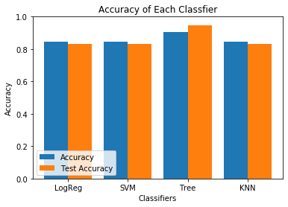
Results
Decision Tree Classifier was the best model to predict successful landings, having accuracy over 87% for the training data and 94% for the actual test data.
Other models and accuracies have been displayed in the bar chart.

Slide 20

Section 2

Slide 21
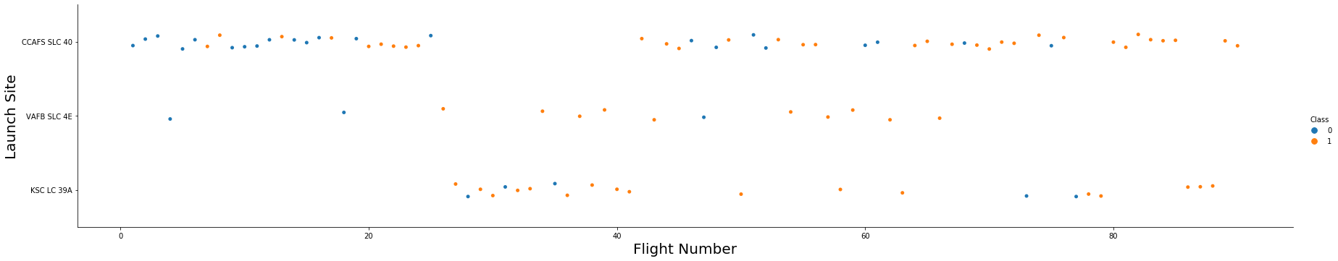
Flight Number vs. Launch Site
Observations:
Recent flights launched from CCAFS SLC 40 have had more consistent successful outcomes than earlier ones.
Site VAFB SLC 4E has had the highest success in between the 3 launch sites.
CCAFS SLC 40 has had the highest number of launches, successes and failures.

Slide 22
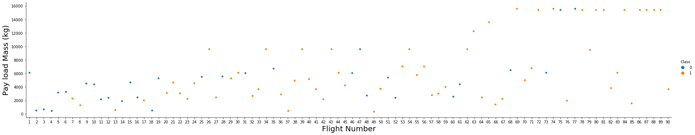
Payload vs. Launch Site
Observations:
Lower payload mass launches seem to have a higher rate of failure than higher payload mass launches.
The recent (with higher payload mass) launches have had more successful outcomes than the earlier launches (with lower payload mass).

Slide 23
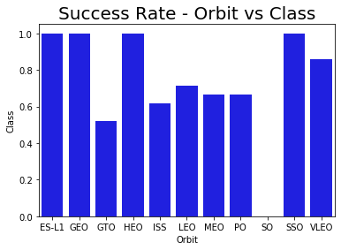
Success Rate vs. Orbit Type
This bar chart shows 100% success in the orbits ES-L1, GEO, HEO, SSO, while 0% success with the SO orbit.
However, the number of flights to the Orbit LEO and GTO has been the highest and that rest of the success rates are based on fewer observations.

Slide 24
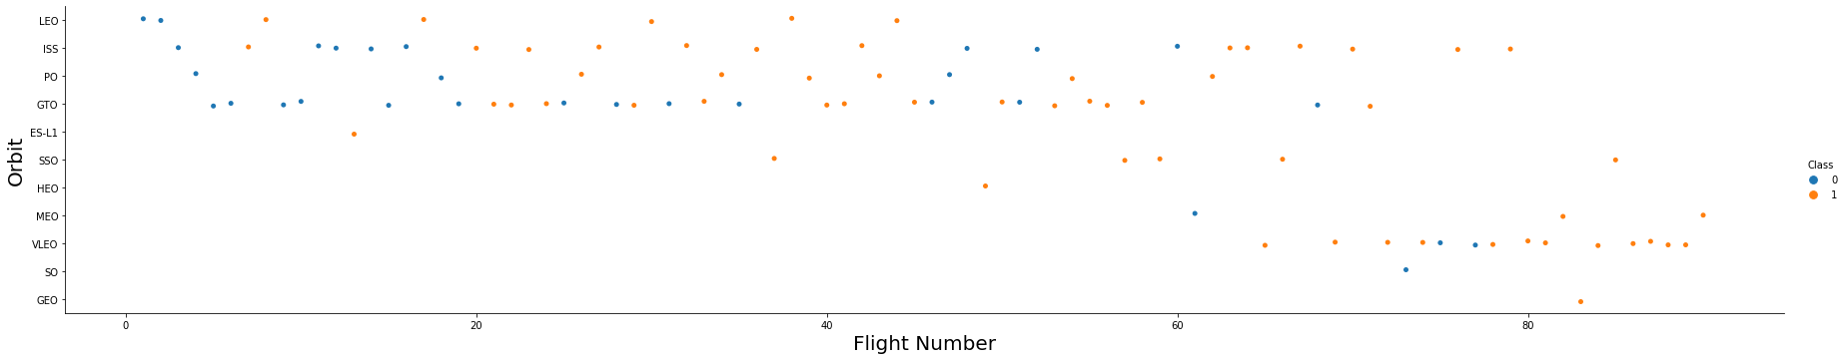
Flight Number vs. Orbit Type
The highest number of observations were available for the GTO and ISS.
For all other orbits, SSO, HEO, GEO, and ES-L1 had a 100% success rate, however the number of observations to use orbit as a successful determinant were less.

Slide 25
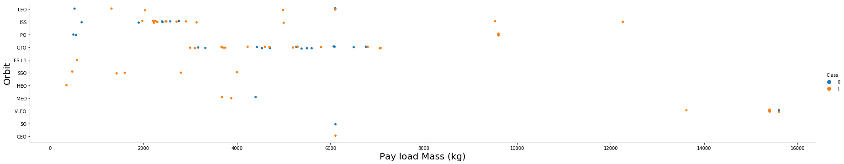
Payload vs. Orbit Type
It is observed from this scatterplot that a successful outcome is highly evident in mission with a higher payload mass (almost greater than 8000 kgs).
Also, the concentration of the points in this scatterplot indicate that payload mass and orbits are highly correlated. This means that the payload mass for missions can be approximately determined based on the orbit the mission is planned for.

Slide 26
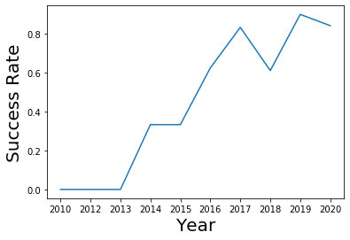
Launch Success Yearly Trend
The success rate has been increasing steadily with the passage of time with the highest success in the year 2019.

Slide 27
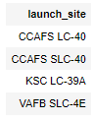
All Launch Site Names
There are 4 launch sites present in the data provided and are present in the screenshot.

Slide 28
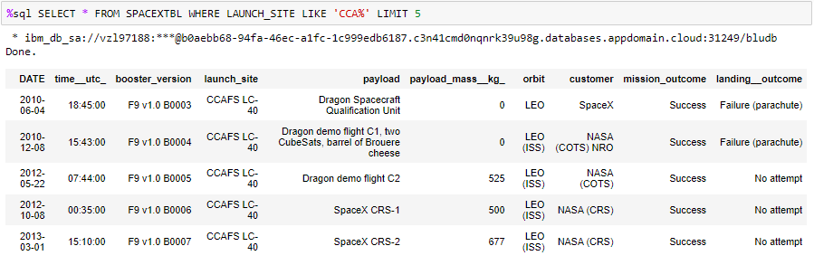
Launch Site Names Begin with 'CCA'
All the 5 mission outcomes from the launch site CCFAS LC-40 were successful. However the landing outcomes were a 100% failure (2 out of 2 attempts). Also all the mission were targeted to the LEO or LEO (ISS) orbits.

Slide 29
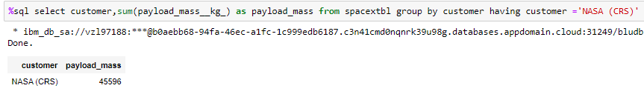
Total Payload Mass
The total payload mass carried by SpaceX for NASA (CRS) is 45,596 kgs.

Slide 30
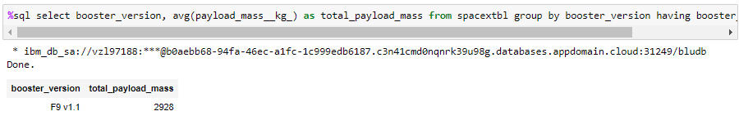
Average Payload Mass by F9 v1.1
The average payload mass carried by F9 v1.1 was 2928 kgs.
* The screenshot contains a typo. The column header should have been avg_payload_mass and not total_payload_mass.

Slide 31
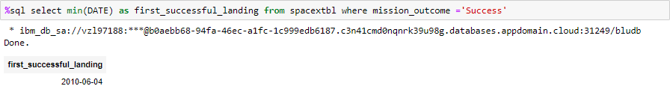
First Successful Ground Landing Date
The first successful ground landing took place on 2010-06-04.

Slide 32
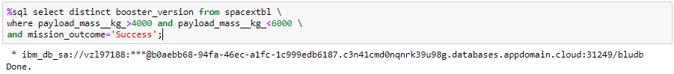
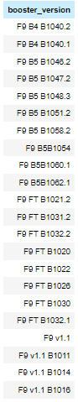
Successful Drone Ship Landing with Payload between 4000 and 6000
Based on the successful mission outcome and payload between 4,000 and 6,000 kgs, it was observed that F9 B5 and FT booster versions were frequently contributing to success which helps us understand that mission outcomes are correlated with the booster versions.

Slide 33
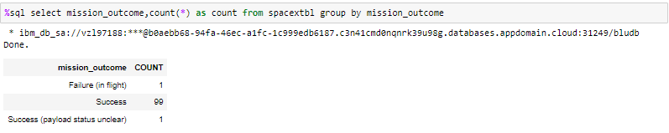
Total Number of Successful and Failure Mission Outcomes
Based on the SpaceX data available, the success rate of the mission outcome was 98.01% (99 out of 101 observations).

Slide 34
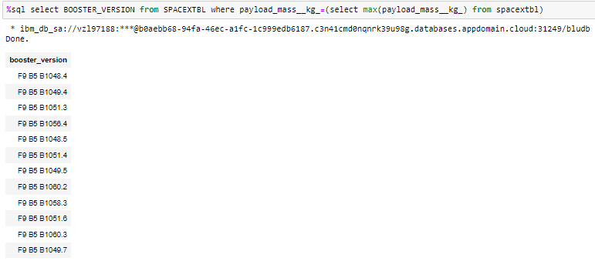
Boosters Carried Maximum Payload
When the data was filtered to identify the booster versions which carried the maximum payload, it was observed that only one booster version F9 B5 was used to carry maximum payload.

Slide 35
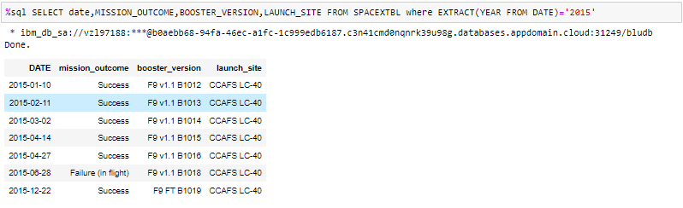
2015 Launch Records
Based on the observations recorded in the year 2015, the mission outcome was 85.17% (6 out 7 attempts).
One common observation is that all the missions took place at the CCAFS LC-40 (mostly using the F9 v1.1 booster version), which helps us understand that the launch site is a key variable which can help determine the landing outcome.

Slide 36
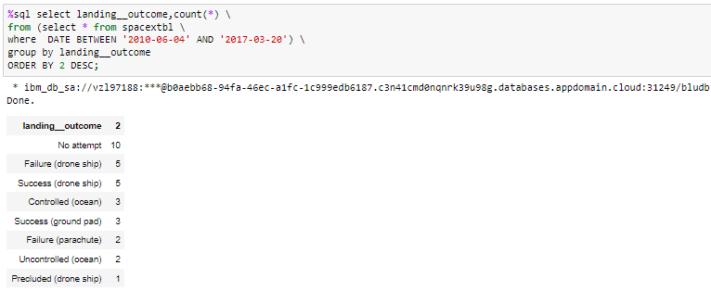
Rank Landing Outcomes Between 2010-06-04 and 2017-03-20
Based on the query, the most frequent observation for the landing outcome was no attempt. However, the success rate for a drone ship was 50% (5 out of 10 attempts)

Slide 37

Section 3

Slide 38
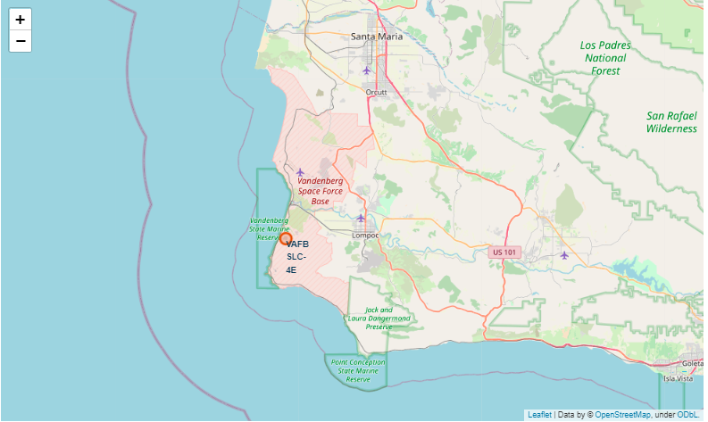
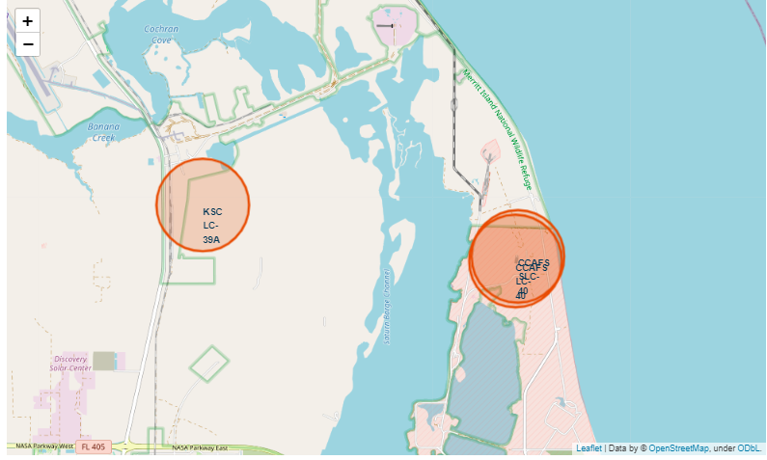
4 Launch Sites on the map of USA
This map shows the location of the 4 launch sites on the map of USA.
CCAFS LC-40
CCFAS SLC-40
KSC LC-39A
VAFB SLC-4E

Slide 39
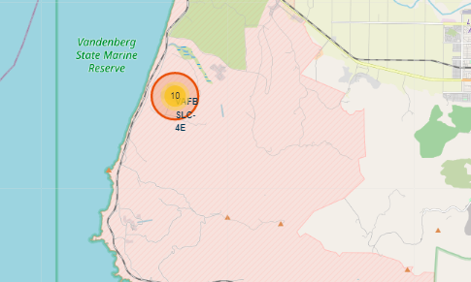
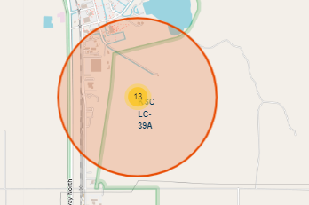
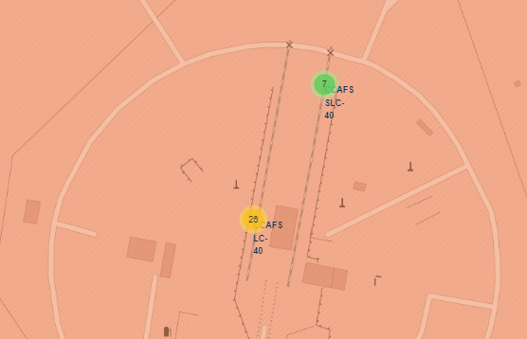
Successful Outcomes at Launch Sites
The launch outcomes are shown in yellow on the map for each launch sites.

Slide 40

Section 4

Slide 41
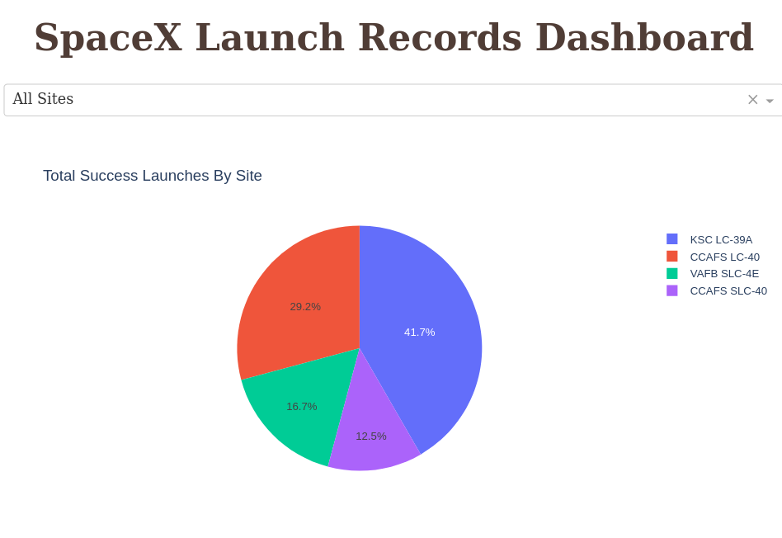
Successful Launches from all Launch Sites
Launch sites seems to be an important contributor in the prediction of a successful outcome.
For example, more successful missions have been observed when launched from KSC LC-39A than CCAFS SLC-40.

Slide 42
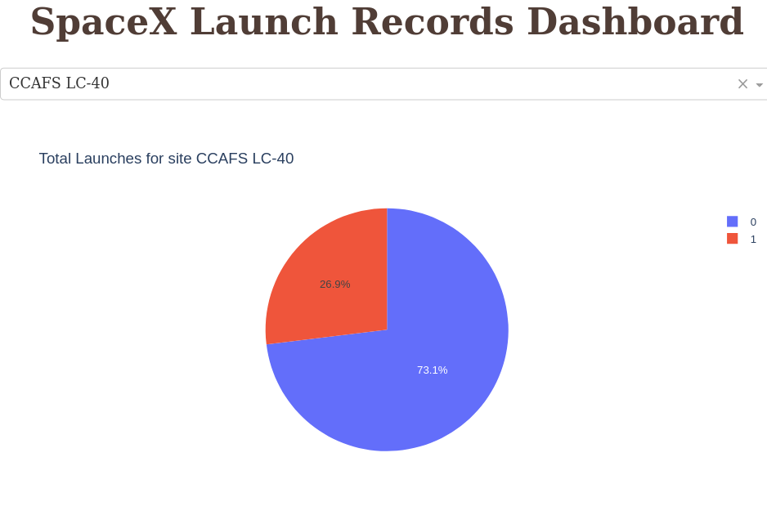
Launch Site with the Highest Success Ratio
The success ratio at CCAFS LC-40 has been the highest among the other launch sites.
Thus, success of a mission is more likely when launched from CCAFS LC-40 than any other launch site.

Slide 43
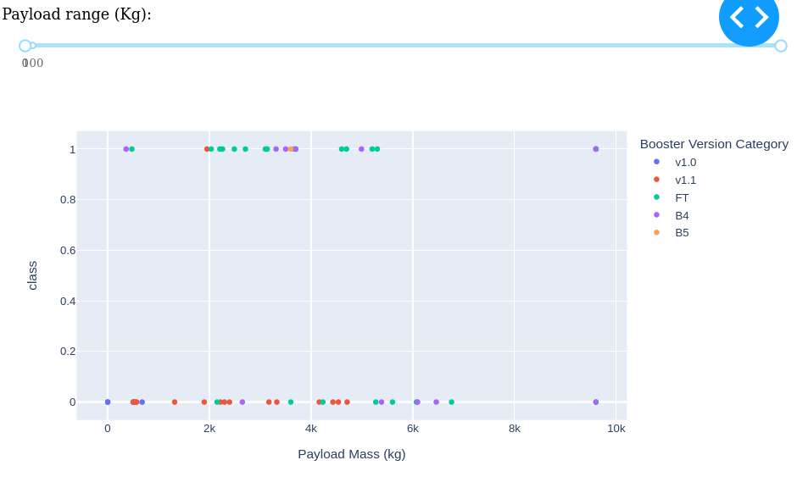
Payload vs. Launch Outcome
Booster versions v1.0 and FT share the highest success when compared to any other boosters for a medium payload.
Also, extremely high and low payloads have had lower chances of success.

Slide 44

Section 5

Slide 45
Classification Accuracy
Four classification models were tested, and their accuracies are plotted beside.
The model with the highest classification accuracy is Decision Tree Classifier, which has accuracy over 87%.

Slide 46
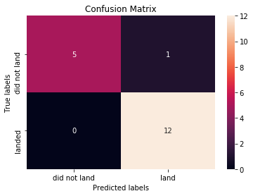
Confusion Matrix
Confusion matrix of Decision Tree Classifier proves that only 1 value was misclassified, rest all being predicted accurately which proves that decision tree classifier is the best model for this project.

Slide 47
Conclusions
Variables such as launch site, payload mass, orbit, booster version were highly useful in determining the success of the mission.
Launches performed from the KSC LC-39A had a higher success ratio than any other site.
Rockets have been more successful post 2013 and has had a higher success rate compared to the earlier years.
Launch sites on the east coast have had more launches and hence more success than on the west coast.
Decision Tree Classifier was the best model with the highest test accuracy.

Slide 48
Appendix
Include any relevant assets like Python code snippets, SQL queries, charts, Notebook outputs, or data sets that you may have created during this project

Slide 49


